Slide 1
The Business Cycle
10 Commerce- Our Economy

Slide 2
Syllabus

Slide 3
The Business Cycle
The cyclical fluctuations in the level of economic activity that an economy goes through over time.

Slide 5
Different stages
Boom
Recession
Depression
Contraction
Expansion

Slide 6
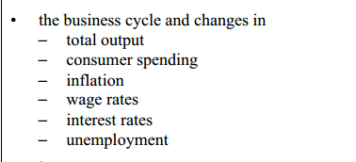
Define the following:

Slide 7
Boom – Up or down?

Slide 8
Recession- Up or down?

Slide 9
Depression –up or down?

Slide 10
Contraction- Up or down?

Slide 11
Expansion

Slide 12
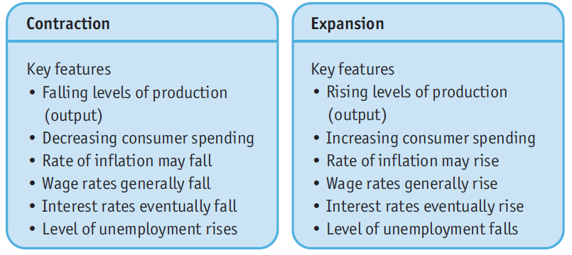
Contraction & Expansion

Slide 13
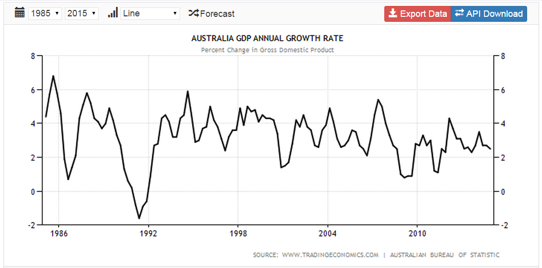
Australia’s Growth rate

